Slide 1
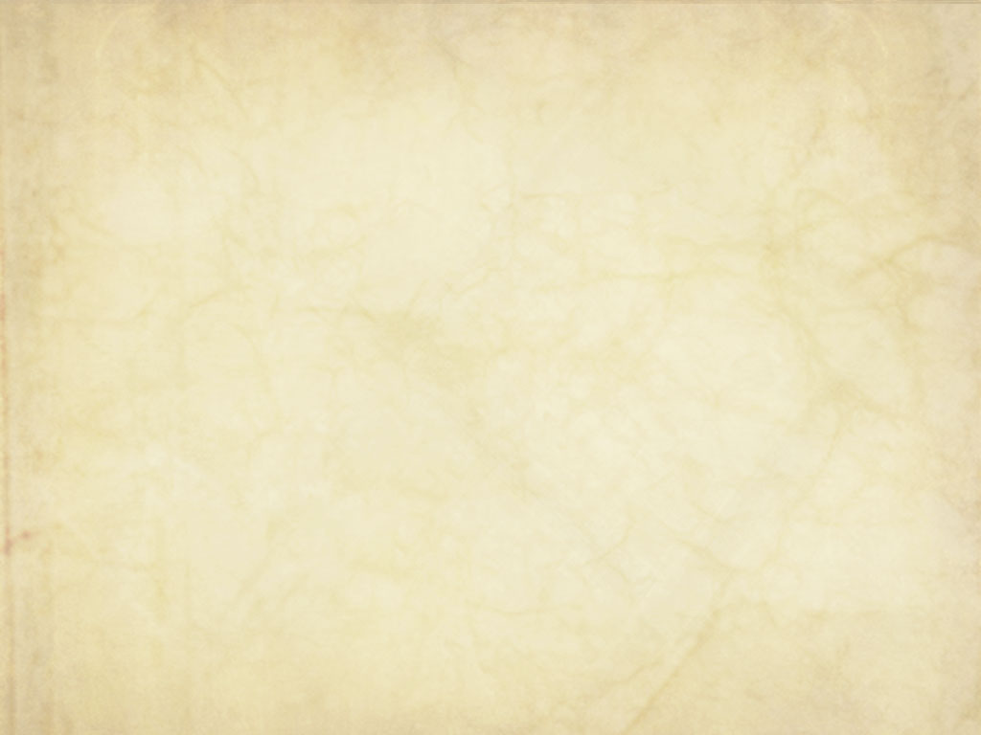
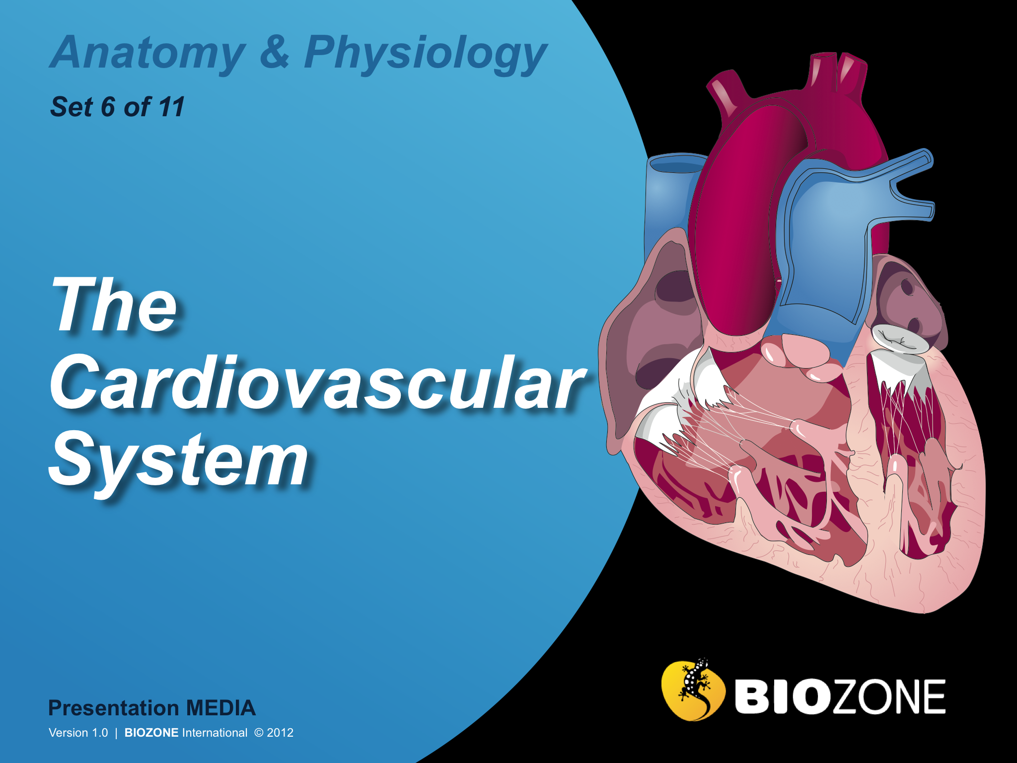

Slide 2
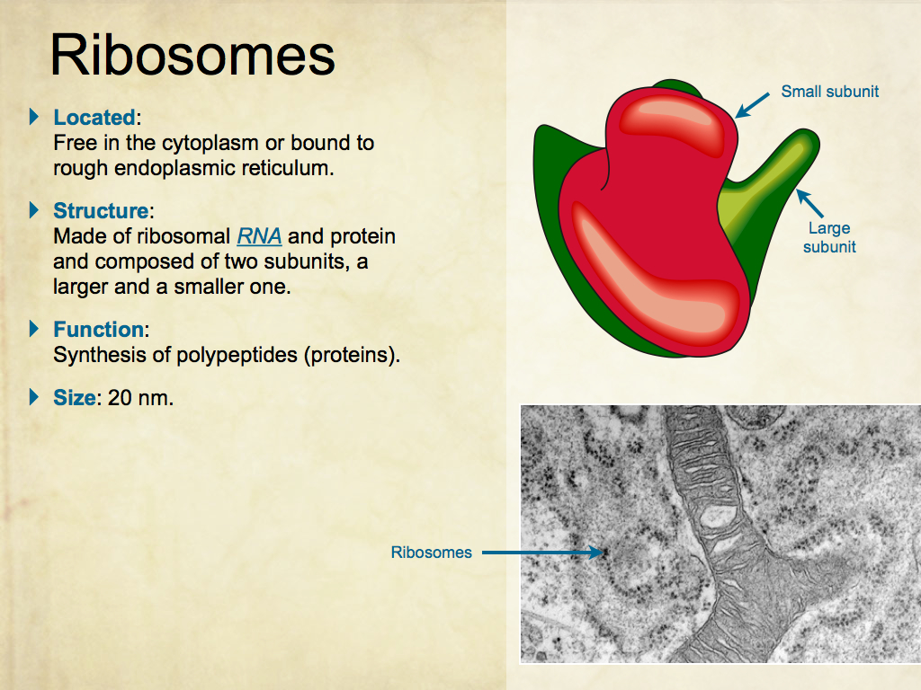
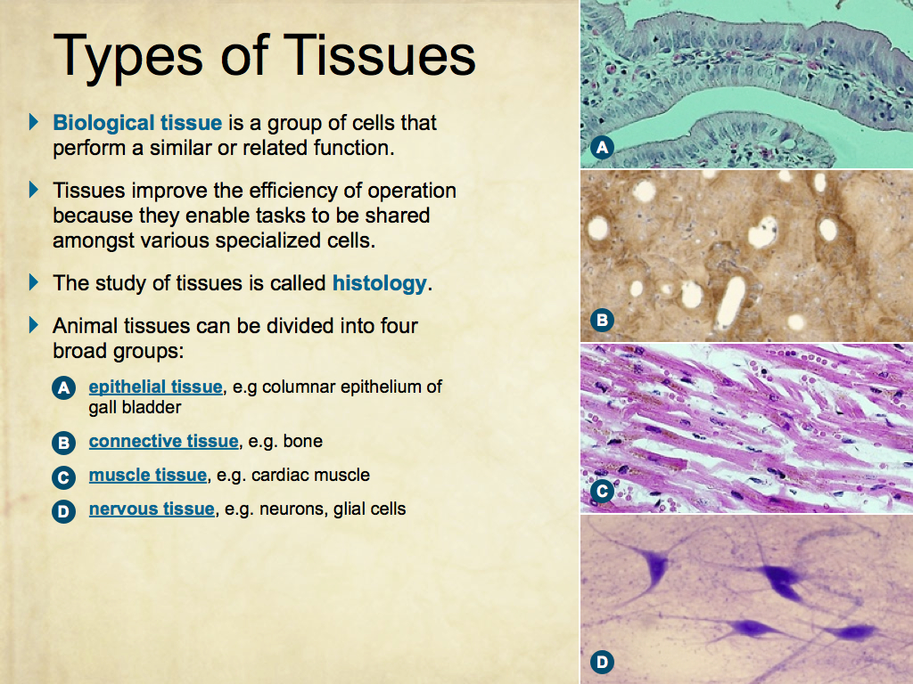
Using Presentation Media
BIOZONE Presentation Media
can be used either as a simple slide show or as an interactive lesson.
  Hyperlinks within the text take you to related slides.
Italicized hyperlinks link to the glossary of definitions.
Bold hyperlinks give direct access to specific slides.

Slide 3
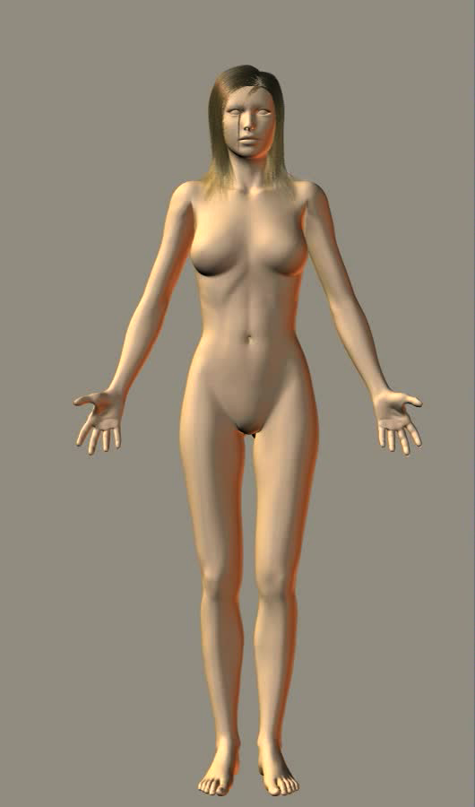
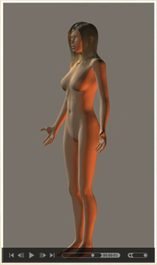
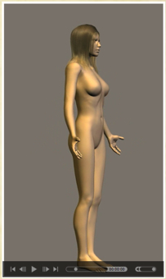
Using Presentation Media
BIOZONE Presentation Media can be used either as a simple slide show or as an interactive lesson
  The movie player allows you to rotate objects.
The movie loops continuously when activated
Use the movie controls in Keynote or Powerpoint
Pause the movie, then drag the slider to rotate the object back and forth

Slide 4
Introduction
  System interaction
  Contexts
The Circulatory System
  Blood vessels
  Blood
  The transport system
The Human Heart
  Human heart structure
  Heart valves
  Control of heart activity
  Heartbeat and blood flow
  Cardiac cycle
Cardiac Output
  Exercise and blood flow
  The effects of training
Cardiovascular Disease
  CVD
  Heart defects
  Correcting heart problems
Glossary

Slide 5
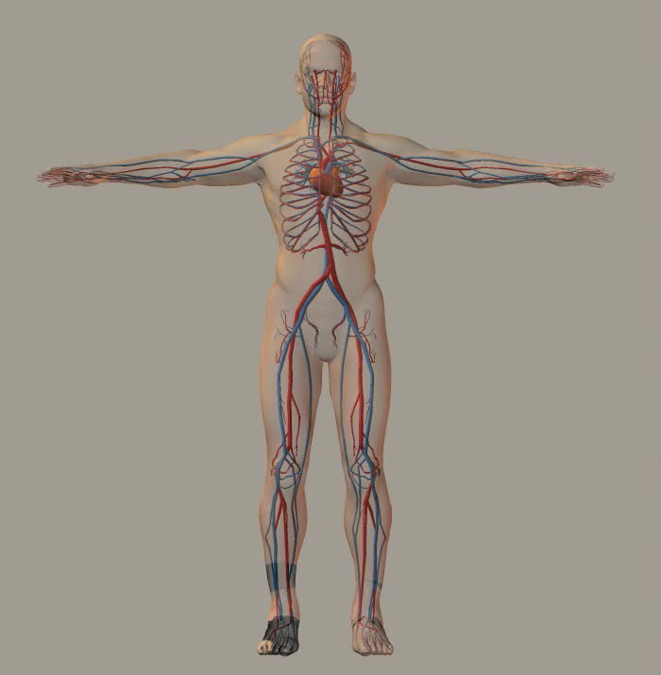
The Cardiovascular System
The cardiovascular system transports blood around the body via a network of
blood vessels.
Blood provides a medium to supply organs and tissues with nutrients and oxygen and remove metabolic wastes for excretion or processing.
It also transports immune elements and aids in
clotting wounds.

Slide 6
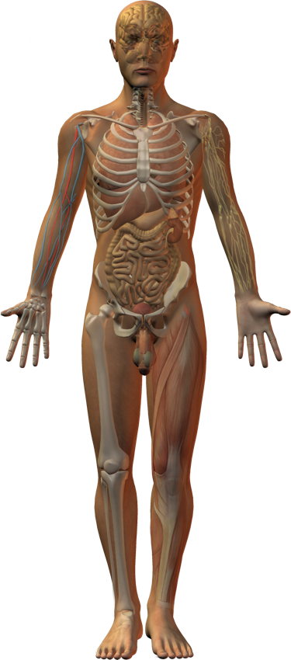
Interacting Systems
Nervous system
Endocrine system
Respiratory system
Lymphatic system and immunity
The cardiovascular system centers on the heart, which pumps blood to the lungs and around the body.
It delivers oxygen and nutrients to organs and tissues, and transports metabolic wastes away for processing and excretion.
The cardiovascular system also serves to transport and distribute heat generated by metabolism.
The interactions of the cardiovascular system with other systems are described in the following slides.
Digestive system
Urinary system
Reproductive system
Integumentary system
Skeletal system
Muscular system

Slide 7
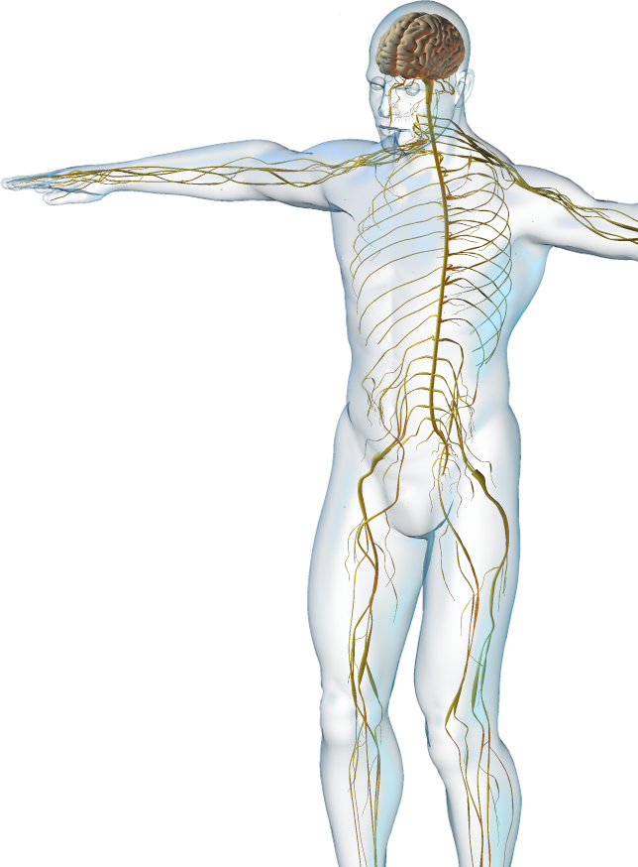
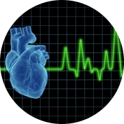

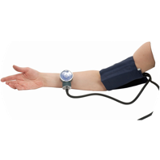
Nervous System
The cardiovascular system interacts with the nervous system.
  The cardiovascular system delivers oxygen to cells and carries away carbon dioxide and other wastes for processing.
  The autonomic nervous system (ANS) regulates heart rate.
  The ANS regulates blood pressure .
Istock
CA

Slide 8
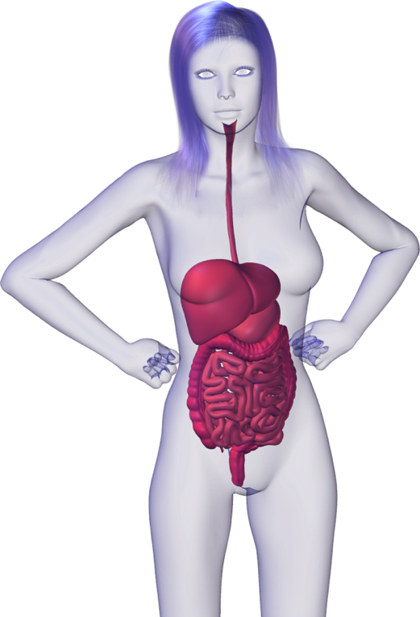
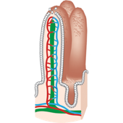
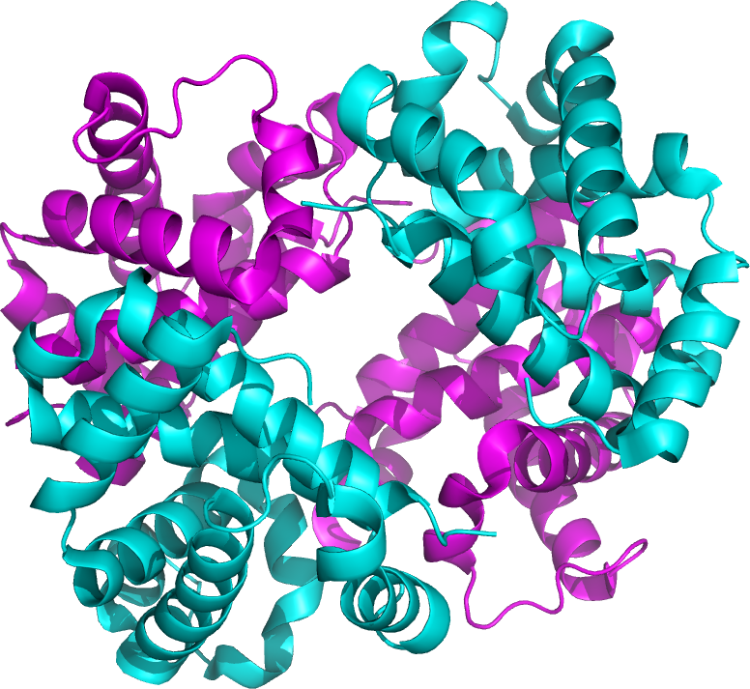
Digestive System
The cardiovascular system interacts with the digestive system.
  The cardiovascular system delivers oxygen to cells and removes carbon dioxide and other wastes.
  The digestive system provides nutrients for blood cells.
  Iron, required for hemoglobin, is ultimately supplied by the digestive system.
Villi
Hemoglobin

Slide 9
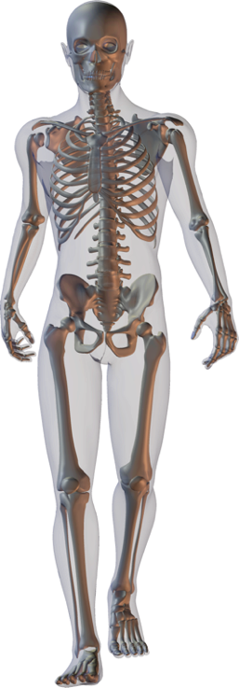
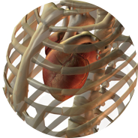
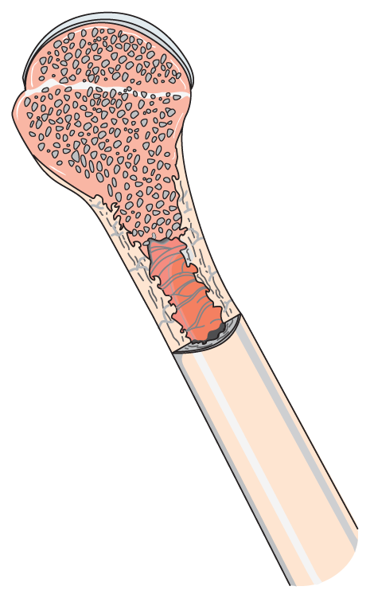
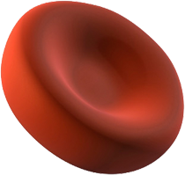
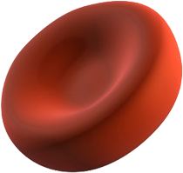
Skeletal System
The cardiovascular system interacts with the skeletal system.
  The cardiovascular system delivers oxygen to cells and removes carbon dioxide and other wastes.
  The skeletal system protects the heart.
  Red marrow is the site of blood
  cell production.

Slide 10
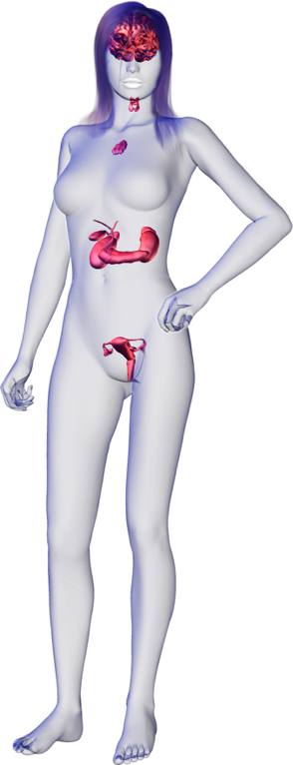
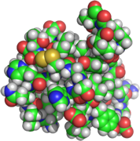
Endocrine System
The cardiovascular system interacts
with the endocrine system.
  The cardiovascular system delivers oxygen to endocrine cells and removes carbon dioxide and other wastes.
  Blood transports hormones throughout the body.
  Some hormones influence blood pressure and the rate and force of heart contraction.
Insulin
CA

Slide 11
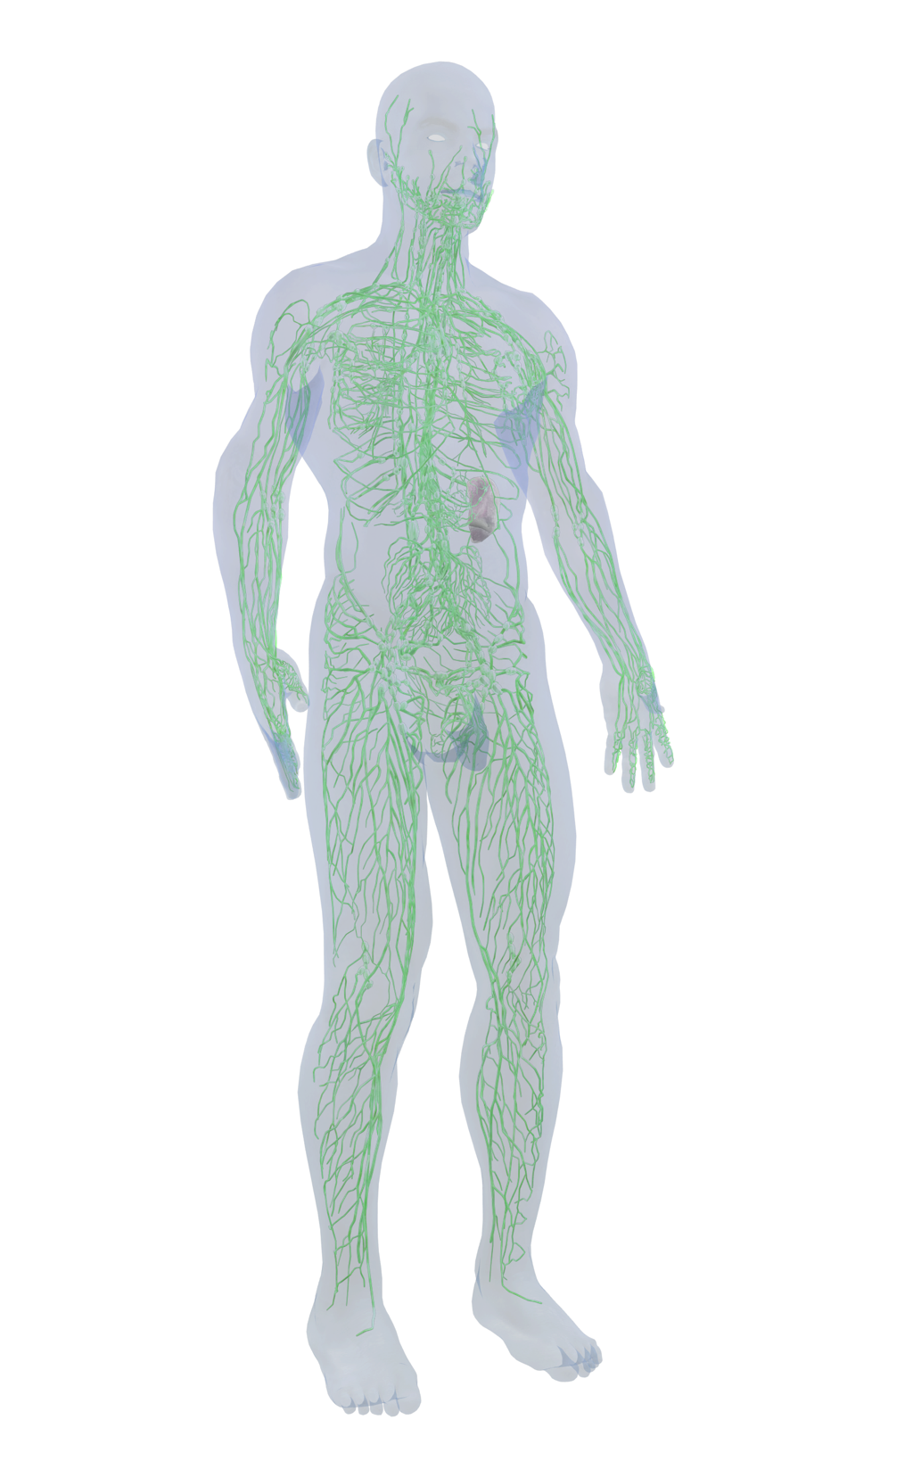
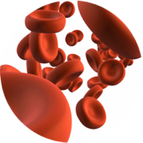
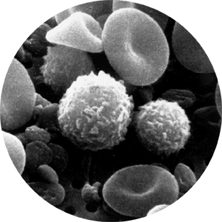
Lymphatic System
The cardiovascular system interacts with the lymphatic system.
  The spleen stores blood, removes aged red blood cells and debris from the blood, and stores iron.
  Immune elements such as lymphocytes circulate within the blood.
  Blood is a source of lymph.
Istock
NCI

Slide 12
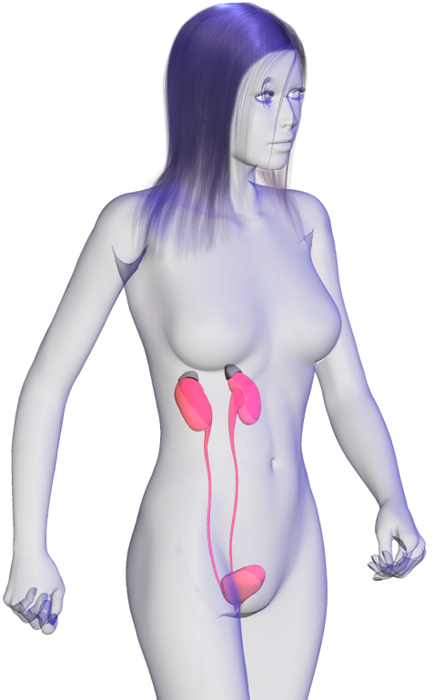
Urinary System
The cardiovascular system interacts with the urinary system.
  The cardiovascular system delivers oxygen to cells and removes carbon dioxide and other wastes.
  The urinary system helps to regulate blood volume and pressure through the renin-angiotensin pathway.
CA

Slide 13
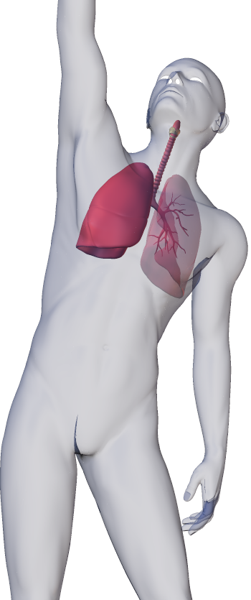
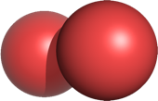
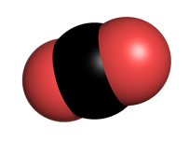
Respiratory System
The cardiovascular system interacts with the respiratory system.
  Respiratory system provides Oxygen which is carried by the blood the cells of the body.
  The respiratory system disposes of carbon dioxide produced by cellular respiration and transported by the blood to the lungs.
O2
CO2

Slide 14
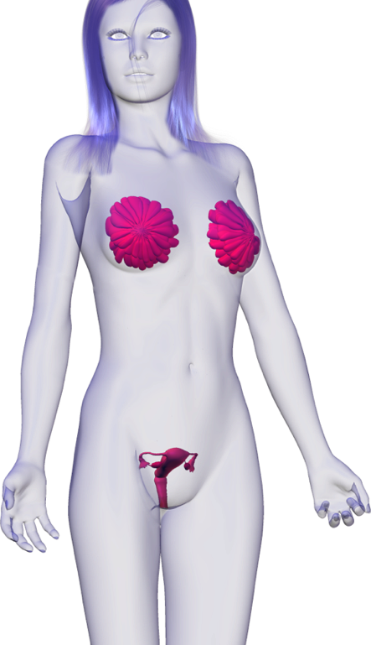
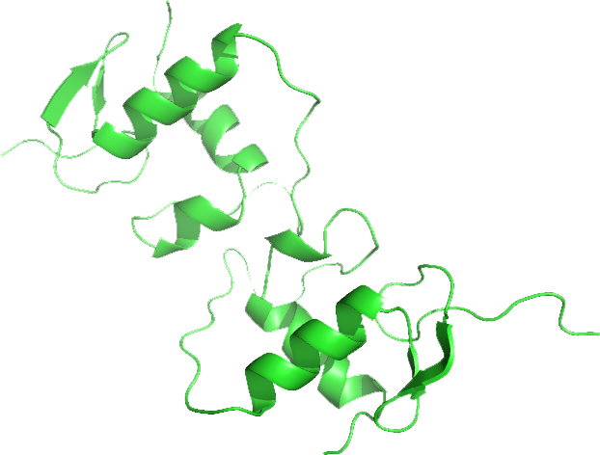
Reproductive System
The cardiovascular system interacts with the reproductive system.
  The cardiovascular system delivers oxygen to cells and removes carbon dioxide and other wastes.
  Estrogen is important in maintaining vascular health in women.
Estrogen

Slide 15
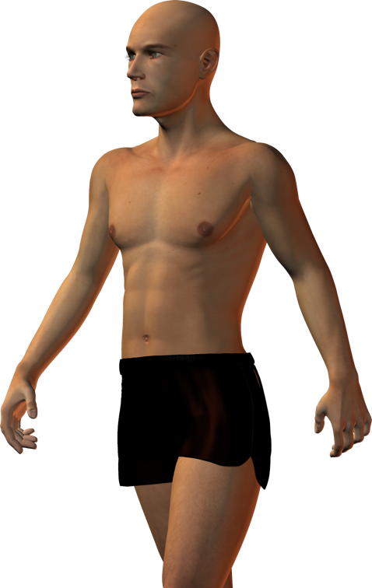
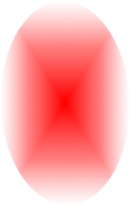
Integumentary System
The cardiovascular system interacts with the integumentary system.
  The cardiovascular system delivers oxygen to cells and removes carbon dioxide and other wastes.
  The skin loses heat delivered to it by the blood, helping to regulate body temperature.
  The skin acts as a reservoir for the blood.

Slide 16
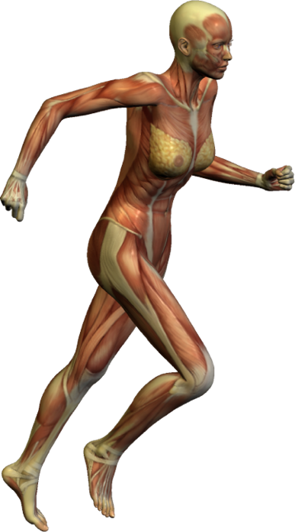
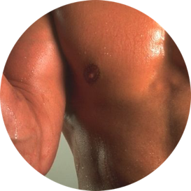
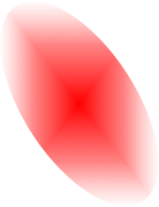
Muscular System
The cardiovascular system interacts with the muscular system.
  The cardiovascular system delivers oxygen to cells and removes carbon dioxide and other wastes.
  Heat generated by muscular movement is transported by the blood to the skin.
  Aerobic exercise increases cardiovascular health and efficiency.
AT

Slide 17
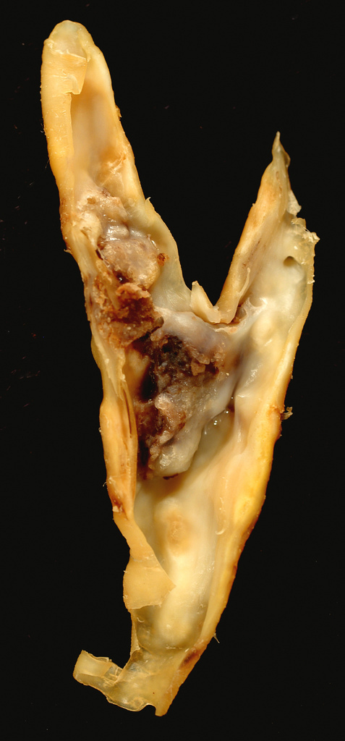
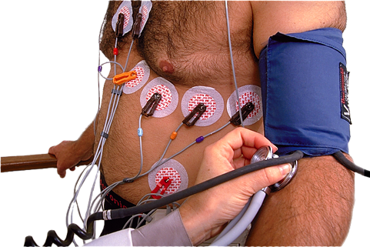
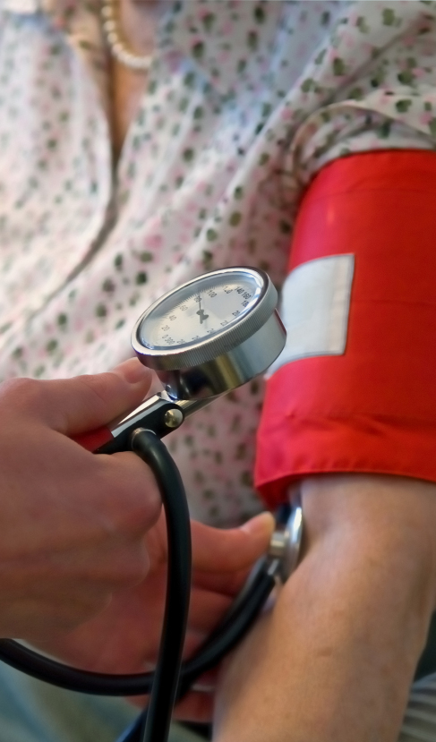
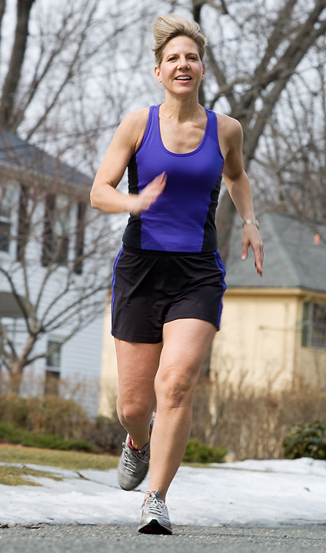
Contexts
Disease
What are the diseases of the cardiovascular system and what are their symptoms?
Medicine and Technology
How do we prevent, diagnose, and treat cardiovascular disease?
Internal Transport
The Cardiovascular System
The cardiovascular and lymphatic systems are linked in a communication network throughout the body.
Exercise and medical therapies can alleviate the symptoms of some age and disease-related changes to these systems.
Photo: Gazelle Technologies Inc.
Ed Uthman CC 2.0
The Effects of Aging
How does aging affect the cardiovascular system?
Exercise
What are the effects of exercise on the cardiovascular system?
iStock
CA
The Effects of Aging
How does aging affect the cardiovascular system.

Slide 18
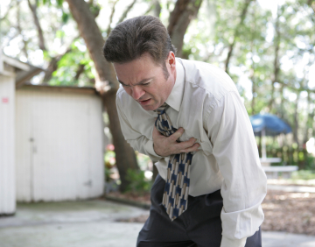
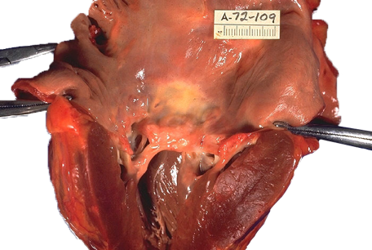
Disease
Cardiovascular disease (CVD) is responsible for 20% of deaths worldwide.
CVD refers to disease of the heart and blood vessels, including artery blockages, valve defects, strokes, and aneurysms.
Symptoms displayed by affected people can be used to diagnose the type of cardiovascular disease.
Istock
Heart disease
CDC

Slide 19
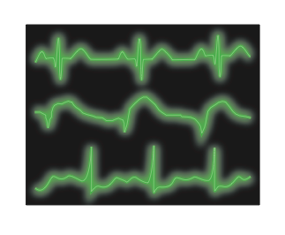
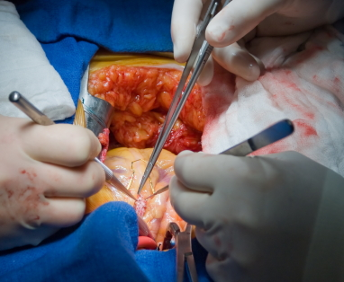
Medicine and Technology
There are numerous medical techniques that can be used to diagnose and treat cardiovascular disease.
Techniques for diagnosis include electrocardiograms, which can detect irregular heart rhythms (arrhythmia).
Heart transplants may be used in some cases. Modern procedures are relatively quick and uncomplicated, taking around half an hour once the patient is anesthetized.
Electrocardiograms can be used to diagnose heart defects.
istock
Heart transplant surgery

Slide 20
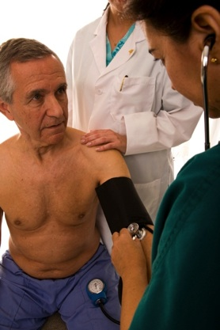
Effects of Age
Cardiovascular function is affected by age. Maximum heart rate and cardiac output decline with age.
Reduction in the heart’s stroke volume contributes up to 50% of the age-related reduction in the capacity for blood flow through the organs and oxygen consumption.
  Maximum heart rate for any given age can be estimated from the equation below*.
HRmax = 220 - age (in years)
Example: 35 years old, maximum heart rate = 185 bpm
    65 years old, maximum heart rate = 155 bpm
    * Regular aerobic training can alter this figure.
istock

Slide 21
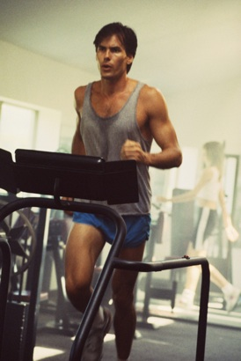
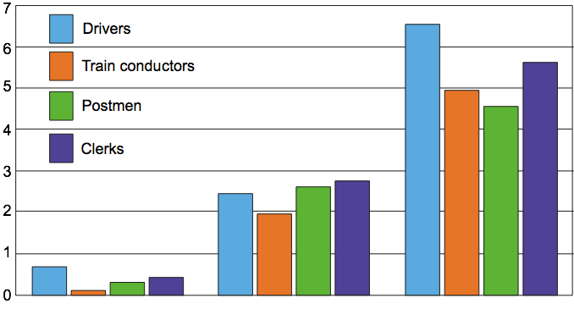
Exercise
Aerobic exercise has both short and long term effects on the function of the cardiovascular system.
Aerobic exercise strengthens the heart muscle, increases its output and lowers blood pressure.
Effects of activity on risk of CHD
CHD rate per 1000
From Morris JN et al
35-45
46-55
56-65
Age (years)
Coronary heart disease (CHD) incidence over various jobs. Note that in all cases the most physical jobs (conductors and postmen) have the least incidence of CHD.

Slide 22
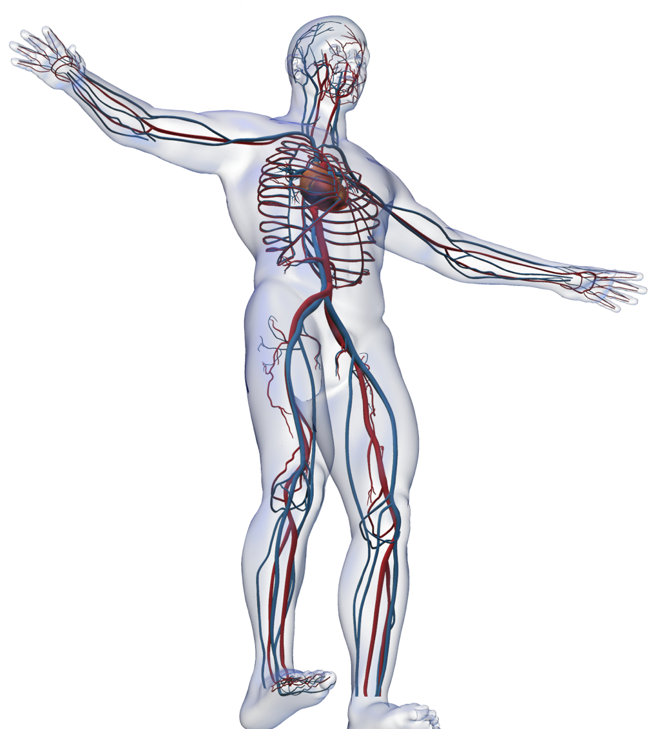
The Cardiovascular System
The cardiovascular system comprises the heart, which acts as a pump to circulate the blood, and blood vessels, which carry the blood to the organs and muscles.
  Arteries cary blood away from the heart (shown as red in the image right).
  Veins carry blood back to the heart (shown as blue in the image).
  The arteries and veins are connected by tiny blood vessels called capillaries.

Slide 23
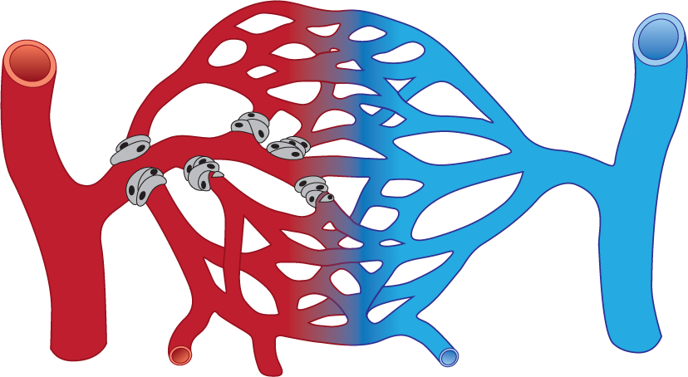
Blood Vessels
Humans, and all vertebrates, have a closed circulatory system composed of tubes that carry blood from the heart to the tissues and then back to the heart.
The blood vessels found in vertebrates are:
  Arteries: carry blood away from the heart.
  Arterioles: Smaller arteries entering a capillary bed.
  Capillaries: transport blood through the organs and tissues.
  Veins: carry blood back to the heart.
  Venules: Collect blood leaving a capillary bed and carry it to the veins.
Vein
Artery
Capillary

Slide 24
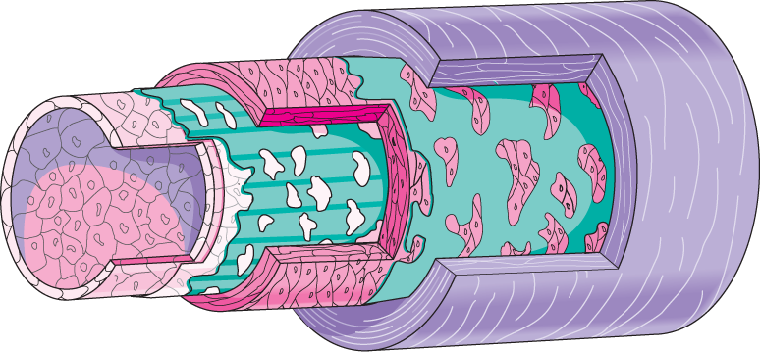
Arteries
Arteries are the large, thick walled vessels that carry blood away from the heart.
  Arteries have an elastic stretchy structure that allows them to withstand the high pressure of blood being pumped from the heart.
  They transport blood to the arterioles, smaller vessels that carry blood to the capillaries.
  They also help to maintain blood pressure by having some contractile ability themselves.
Endothelium
Basement membrane
Internal elastic lamina
Smooth muscle
External elastic lamina
Tunica externa
Tunica interna
Tunica media

Slide 25

Arteries
Large arteries can be divided into conducting arteries and distributing arteries.
  Conducting (= elastic) arteries include the aorta and pulmonary artery.
    Their walls contain elastic fibers
    that recoil between heartbeats and smooth out the flow of blood through the vessel, keeping blood pressure relatively constant.
  Distributing (= muscular) arteries, such as the brachial and femoral arteries, contain a large amount of smooth muscle.
    They have roles in vasoconstriction and vasodilation to adjust the rate of blood flow and blood pressure.
Cross section of an artery showing the thick muscular wall. Red blood cells can be seen in the lumen (middle).

Slide 26

Veins
Veins are blood vessels that return blood to the heart from the tissues and organs.
  Venules collect blood from the capillaries and transport it to the veins.
  Veins are made of the same three layers as arteries but have thinner walls and a larger diameter lumen.
Endothelium
Basement membrane
Tunica interna
Blood flow
Tunica media
In smaller venules, this layer is missing.
Smooth muscle
Tunica externa
Veins contain valves that prevent blood from flowing in the wrong direction, especially in the arms and legs.

Slide 27

Veins
Blood flowing in the veins has lost a lot of pressure after flowing through the capillaries.
  Valves prevent backflow in blood returning to the heart.
  Blood leaving a cut vein slowly oozes out, unlike arteries where blood tends
  to spurt out.
Veins are less elastic than arteries, but are somewhat capable of adapting to changes in blood pressure and volume.
Vein with thin walls
Artery with thick walls
EII

Slide 28

Capillaries
Capillaries are very small blood vessels that connect arterial and venous circulation and enable exchange of nutrients and wastes between blood and tissues.
  Capillaries are composed of a single layer of endothelium.The endothelium is composed itself of squamous epithelial cells.
  Capillaries form networks or beds. They are abundant where metabolic rates are high.
Capillary wall
Blow flow is slow (<1 mm per second)
Red blood cell with diameter of 7 µm just squeezes through
The capillary itself has a diameter 4-10 µm
Tissue cells
Large proteins remain in the capillary in solution

Slide 29

Exchanges in the Capillaries
Tissue cell
Fluid leaks from capillaries through small gaps where endothelial cells join.
The fluid bathes the tissues supplying nutrients and oxygen.
No cell is more than 25 µm away from a capillary.
Capillary walls are thin enough to allow all the exchanges of materials between tissue and blood cells to take place.
Wastes
RBC
Nutrients
Oxygen
Capillary
Tissue fluid
Tissue fluid leaks from the capillaries. Nutrients and wastes are exchanged across the capillary wall, traveling through the tissue fluid.

Slide 30



Types of Capillary
Continuous capillary
Capillaries may be continuous, fenestrated, or sinusoid.
  Continuous capillaries have gaps between cells but continuous plasma membranes.
  Fenestrated capillaries have endothelial cells with many large pores (fenestrations) in the plasma membrane.
    Fenestrated capillaries are found in the small intestine, glomerulus, parts of the brain, the eyes, and endocrine glands.
  Sinusoids are capillaries that are slightly wider than normal and contain gaps between the epithelial cell.
    Sinusoids can be found in the liver, spleen, and bone marrow.
Pores within plasma membrane
Fenestrated capillary
Gaps between cells
Sinusoidal capillary

Slide 31


Capillary Networks
Fat cell
Capillaries are found near almost every cell in the body.
In many places, the capillaries form extensive branching networks.
In most tissues when metabolic demands of the tissue are low, blood flows through only a small portion of a capillary network.
When tissue becomes active the blood fills the entire capillary network fills with blood.
Capillary
University of Delaware
Capillary
CDC

Slide 32

Capillary Networks
The flow of blood through a capillary bed is called microcirculation.
In most parts of the body there
are two types of vessel in a
capillary bed:
  True capillaries, where exchanges take place.
  Vascular shunt: which connects the arteriole and venule at either end of the capillary bed.
The shunt diverts blood past the true capillaries when metabolic demands are low.
Terminal arteriole
Post-capillary venule
Smooth muscle sphincter (contracted)
Vascular shunt
When the sphincters contract, blood is diverted via the vascular shunt to the post-capillary venule, bypassing the exchange capillaries.

Slide 33
Capillary Networks
When the sphincters are relaxed, blood flows through the entire capillary bed. This allows exchanges with the cells of the surrounding tissue.
Terminal arteriole
Post-capillary venule
Smooth muscle sphincter (relaxed)
True capillaries

Slide 34

Capillary Networks
A portal venous system occurs when a capillary bed drains into another capillary bed through veins before returning to the heart.
Portal systems are uncommon, but one example is the hepatic portal system.
Gut capillaries
Liver sinusoids
Liver cells
Nutrient rich portal blood has high solute concentration.
Arterial blood
Venous blood
Nutrients (e.g. glucose) and toxins are absorbed from the gut into the capillaries.
Portal blood passes through the liver lobules where nutrients and toxins are absorbed, excreted, or converted.

Slide 35

Tissue Fluid
Tissue fluid forms from the fluid that leaks out of the capillaries.
The movement into and out of a capillary depends on the balance between the blood pressure and the solute potential at the end a capillary bed.
Not all the fluid that leaks from the capillaries is returned to the capillaries.
This fluid is collected by the vessels of the lymphatic system and becomes lymph.
Blood flow inward
Lymph vessel
Arteriole
Venule
Blood flow outward

Slide 36

Formation of Tissue Fluid
At the arteriolar end of a capillary bed, hydrostatic (blood) pressure (HP) forces fluid out of the capillaries and into the tissue fluid.
At the venous end of a capillary bed, hydrostatic pressure drops and most (90%) of the leaked fluid moves back into the capillaries.
Glucose, water, amnio acids, ions, and oxygen
As fluid leaks out through the capillary walls, it bathes the cells of the tissues.
Water, CO2, and other wastes. 90% of leaked fluid
10% of leaked fluid is collected by lymph vessels and returned to the circulation near the heart
Arteriolar end of a capillary bed
there is a net outward pressure: water and solutes leave the capillary.
Venous end of a capillary bed there is net inward pressure: water and solute re-enter the capillary.

Slide 37
Summary of Blood Vessels
Relative tissue makeup
Average lumen diameter and wall thickness
Vessel type
Smooth muscle
Elastic tissue
Fibrous tissue
Endothelium
Diameter: 1.5 cm
Thickness: 1.0 cm
Conducting (elastic) artery
Diameter: 6.0 mm
Thickness: 1.0 mm
Distributing (muscular) artery
Diameter: 37.0 µm
Thickness: 6.0 µm
Arteriole

Slide 38
Summary of Blood Vessels
Relative tissue makeup
Average lumen diameter and wall thickness
Vessel type
Smooth muscle
Elastic tissue
Fibrous tissue
Endothelium
Diameter: 9.0 µm
Thickness: 0.5 µm
Capillary
Diameter: 20.0 µm
Thickness: 1.0 µm
Venule
Diameter: 5.0 µm
Thickness: 0.5 µm
Vein

Slide 39

Blood
Blood is a complex mixture comprising cellular components suspended in a solution of proteins and ions called plasma.
Blood performs many functions:
  Transports
    nutrients
    respiratory gases
    hormones
    cellular wastes
  Blood contains many immune elements for protection against pathogens.
  Blood helps thermoregulation by distributing heat through the body.
istock

Slide 40

Blood
Blood is made up of plasma and various type of cells.
The plasma is a watery matrix of ions and proteins. It makes up 50-60% of the blood volume. Water
The cellular portion of the blood makes up 40-50% of the total volume.
It is made up of many types of blood cell including:
  red blood cells
  platelets (cell fragments)
  various types of white blood cell.
Plasma (50-60% of total blood volume)
Cellular components (40-50% of total volume)

Slide 41

Plasma
Water:
Water is the main constituent of blood and plasma.
Role:
Transports dissolved substances. Provides body cells with water. Distributes heat and has a central role in thermoregulation. Regulation of water content helps to regulate blood pressure and volume.
Mineral ions:
Sodium, bicarbonate, magnesium, potassium, calcium and chloride.Role:
Osmotic balance, pH buffering, regulation of membrane permeability, and a variety of other functions. Ca²⁺ is involved in blood clotting.
Substances transported by non cellular components:
Products of digestion:
sugars, fatty acids, glycerol, and amino acid.
Excretory products:
Urea
Hormones and vitamins:
insulin, sex hormones vitamins A and B12.
istock

Slide 42





Role of Plasma Proteins
Serum albumin
Plasma proteins. 7-9% of plasma volume.
  Serum albumin
    Role: Osmotic balance and pH buffering, Ca2+ transport.
  Fibrinogen and prothrombin
    Role: Take part in blood clotting
  α-globulins
    Role: Bind/transport hormones, lipids, fat soluble vitamins
  β-globulins
    Role: Bind/transport iron, cholesterol, fat soluble vitamins
  Enzymes
    Role: Take part in and regulate metabolic activities.
Fibrinogen
Prothrombin
α-globulins
β-globulin

Slide 43

Cellular Blood Components
Erythrocytes (red blood cells, RBCs):
5-6 million per mm³ of blood 38-48% of total blood volume
Role:
RBCs transport oxygen (O2) and a small amount of carbon dioxide (CO2). The oxygen is carried bound to hemoglobin (Hb) in the cells. Each Hb molecule can bind four O2 molecules.
Platelets:
Small membrane bound fragments derived from bone marrow cells: about one quarter the size of RCBs. 0.25 million per mm³ of blood
Role:
To start the blood clotting process.
Leukocytes (White blood cells, WBCs):
Play an important part in defense against pathogens.
COR

Slide 44




White Blood Cells
There are 5-10 000 leukocytes (white blood cells, WBCs) per mm³ blood (2-3 % of total blood volume).
Role: Involved in internal defense. There are several types of white blood cell.
  Lymphocytes: T and B cells 24% of the WBC count
    Role: Antibody production and cell
    mediated immunity
  Neutrophils: Phagocytes. 70% of the WBC count
    Role: Engulf foreign material
  Basophils: Rare leukocytes; normally 0.5% of
  WBC count.
    Role: Produce heparin (an anti clotting protein), and histamine. Involved in inflammation.
  Eosinophils: Rare leukocytes; normally 1.5% of WBC count.
    Role: Mediate allergic responses such as hayfever and asthma
Wiki CC 3.0
Lymphocyte
Bob Blaylock CC 3.0
Neutrophil
CS99
Basophil
Bobjgalindo CC 3.0
Eosinophil

Slide 45


Examining the Blood
Different types of microscopy give different information about blood.
An SEM shows the detailed external morphology of the blood cells.
A fixed smear of a blood sample viewed with a light microscope can be used to identify different blood cell types present and their ratio to each other.
Determining the types and proportions of blood cells is called a differential white blood cell count.
  Elevated counts of particular cell types indicate allergy or infection.
Image:NCI Frederick
SEM of RBC, platelet, and WBC
WBC
RBCs
EII
RBCs and WBCs viewed through a light microscope

Slide 46

Transport System
Brain
Pulmonary system
Lungs
The blood vessels of the circulatory system form a vast network of tubes that carry blood away from the heart to the organs and tissues of the body and then return it to the heart.
Humans (like all mammals) have a double circulatory system:
  The pulmonary system which carries blood between the heart and lungs.
  The systemic system which carries blood between the heart and rest of the body.
Liver
Gut
Kidneys
Systemic system
Lower body

Slide 47

Arterial System
The arterial system delivers blood from the heart to the organs and tissues.
Pulmonary artery:
Carries deoxygenated blood to the lungs
Aorta: Main artery leaving the heart for the body
Left atrium: Receives oxygenated blood from the lungs
Left ventricle: Pumps blood from the left atrium to the aorta
Hepatic artery: Carries oxygenated blood to the liver.
Mesenteric artery: Carries oxygenated blood to the gut
Renal artery: Carries oxygenated blood to the kidneys

Slide 48
Venous System
The venous system receives blood from the organs and tissues and carries it to the heart.
Superior vena cava: Receives deoxygenated blood from the head and body
Right atrium: Receives deoxygenated blood via the superior and inferior vena cavae
Inferior vena cava: Receives deoxygenated blood from the lower
Hepatic vein: Carries deoxygenated blood from the liver
Hepatic portal vein: Carries deoxygenated nutrient rich blood from the gut from processing
Renal vein: Carries deoxygenated blood from the kidneys

Slide 49




Mammalian Heart Structure
The heart is four chambered, with two atria and two ventricles.
The muscular wall of the left ventricle (which pumps blood to the body) is much thicker than that of the right ventricle.
Valves between the atria and ventricles stop blood flowing from the ventricles to the atria when the ventricles contract.
Left atrium
Right atrium
Right ventricle
Right ventricle
Valve
Valve
Right ventricle
Right ventricle
Left ventricle
Anterior view of mammalian heart
Posterior view of mammalian heart
All photos: K Pryor

Slide 50

Asymmetry of the Heart
The asymmetry is related to the necessary pressure differences between the pulmonary and systemic circulations not the distance the blood must travel.
  The pulmonary circuit operates at a much lower pressure than the systemic circuit to prevent fluid accumulating in the alveoli in the lungs.
  The left side of the heart must develop enough pressure to enable increased blood flow to the muscles and maintain kidney filtration without decreasing the blood supply to the brain.
Blood pressure during contraction (systole)
The greatest fall in pressure occurs when the blood moves into the capillaries, even though the distance through the capillaries represents only a tiny proportion of the total distance traveled.
Blood pressure during relaxation (diastole)

Slide 51

The Human Heart
The heart is the center of the cardiovascular system.
Each day it beats over 100 000 times to pump
3780 liters of blood through 100 000 kilometers of blood vessels.
It comprises a system of four muscular chambers that alternately fill and empty with blood.

Slide 52


The Human Heart
The heart lies between the lungs, to the left of the body’s midline.
It is surrounded by a double layered pericardium of tough fibrous
connective tissue.
The pericardium prevents over-distention of the heart within the mediastinum.

Slide 53

Human Heart Structure
Aorta
Vena Cava
Pulmonary Artery
Left Atrium
Right Atrium
Right Ventricle
Left Ventricle
External Structure of the Heart

Slide 54

Human Heart Structure
Aorta
Vena Cava
Pulmonary Artery
Left Atrium
Right Atrium
Right Ventricle
Left Ventricle
Internal Structure of the Heart

Slide 55
Human Heart Structure
Bicuspid valve
Semi-lunar valve
Tricuspid valve
Septum
Chordae tendinae
Internal Structure of the Heart

Slide 56

Heart Valves
The flow of blood through the heart is controlled by four valves.
The atrioventricular valves lie between the atria and ventricles.
The exits from the heart, the pulmonary valve and the aortic valve, are controlled
by semilunar valves which prevent blood flowing back into the heart from the arteries.
Pulmonary valve
Aortic valve
Bicuspid (left atrioventricular valve)
Superior view of heart showing position of valves
Tricuspid (right atrioventricular valve)

Slide 57

Control of Heart Activity
When removed from the body, the heart continues to beat.
This indicates that the origin of the contractions is myogenic - it is an intrinsic property of the cardiac muscle itself.
The heartbeat is regulated by a special conduction system consisting of:
  A pacemaker (sinoatrial node (SAN)) which sets the basic rhythm of the heart, but is influenced by the cardiovascular control centre.
  Specialized conduction fibers called Purkinje fibers which conduct electrical signals through the heart.

Slide 58


Generation of Heartbeat
Intercalated discs
Mitochondrion
The basic rhythmic heartbeat is myogenic.
  The nodal cells spontaneously generate rhythmic action potentials without
  neural stimulation.
Each muscle cell (fiber) has one or two nuclei and many mitochondria.
Intercalated discs are specialized regions between cells that support synchronized contraction of the muscle.
  They contain gap junctions, specialized electrical synapses which allow very rapid spread of nerve impulses through the heart.
Cardiac muscle fibers
Capillary
Nucleus
Intercalated discs
Mitochondrion
EII

Slide 59

Control of Heartbeat
The SAN acts as the heart’s pacemaker.
  It is a mass of specialized muscle cells near the entry point of the superior vena cava.
  The SAN initiates the cardiac cycle, spontaneously generating action potentials which cause the atria to contract.
The atrioventricular node (AVN) at the base of the atrium briefly delays the impulse from the SAN to allow time for the atrial contraction to finish before the ventricles contract.
The bundle of His is a tract of conducting fibers that distribute the action potentials over the ventricles causing ventricular contraction.
Sinoatrial node
Atrioventricular node
Bundle of His
Purkinje fibers
Spread of impulses across atria
Spread of impulses to ventricles

Slide 60

ANS Control of Heartbeat
The cardiovascular control center comprises the accelerator center (acts to speed heart rate and force of contraction) and the inhibitory center (acts to decrease heart rate and force of contraction).
  The accelerator centre also responds directly to adrenaline and to changes in the blood composition (low blood pH or low oxygen). These responses are mediated through the sympathetic nervous system.
+
–
Sympathetic nervous stimulation via the cardiac nerve increases heart rate through the release of noradrenaline.
Parasympathetic nervous stimulation via the vagus nerve decreases heart rate through the release of acetylcholine.

Slide 61

ANS Control of Heartbeat
Cerebral hemispheres may send impulses (e.g. in sexual arousal).
Hypothalamus may send impulses (e.g. in anger or alarm).
The carotid reflex: Pressure receptors in the carotid sinus detect stretch caused by increased arterial flow (blood flow leaving the heart). They send impulses to the inhibitory centre to mediate decrease in heart rate via the vagus nerve (parasympathetic stimulation).
The aortic reflex: Pressure receptors in the aorta detect stretch caused by increased arterial flow. They send impulses to the inhibitory center to mediate decrease in the heart via the vagus nerve.
The Bainbridge reflex: Pressure receptors in the vena cava and atrium respond to stretch caused by increased venous return by sending impulses to the accelerator center, mediating an increase in heart rate.

Slide 62
Heartbeat and Bloodflow
The ventricles provide the heart’s power, with thick muscular walls pumping blood into the arteries.
The atria have thin walls and partly act as reservoirs to receive blood from the veins.
Aorta
Superior vena cava
1
Pulmonary artery
Late diastole (relaxation)
Blood enters the atria, causing them to balloon slightly.
Deoxygenated blood from the body enters the right atrium from the vena cavae.
Oxygenated blood from the lungs enters the left atrium from the pulmonary vein.

Slide 63
Heartbeat and Bloodflow
2
Atrial contraction
Atrial walls contract, pushing blood into the ventricles.
Oxygenated blood in the left atrium enters the left ventricle through the bicuspid valve.
Deoxygenated blood in the right atrium enters the right ventricle through the tricuspid valve.

Slide 64
Heartbeat and Bloodflow
3
Ventricle contraction
Blood in the right ventricle exits through the pulmonary valve into the pulmonary artery, flowing to the lungs.
Blood in the left ventricle exits the heart through the aortic valve, flowing to the body.
The most powerful phase of the heartbeat. Ventricle walls contract, forcing blood at high pressure into the arteries.

Slide 65
Heartbeat and Bloodflow
4
Early diastole (relaxation)
Aortic and pulmonary valves snap shut, preventing blood flowing backwards into the heart.
Tricuspid and bicuspid valves reopen
Ventricle walls relax. Pressure in the heart reduces.

Slide 66

Cardiac Cycle
The heart pumps with alternative contractions (systole) and relaxations (diastole).
The heartbeat occurs in response to electrical impulses, which can be recorded as a trace called an electrocardiogram (ECG).
The ECG pattern is the result of the different impulses produced at each phase of the cardiac cycle.
  An ECG provides a useful method of monitoring changes in the heartbeat.
Photo: Gazelle Technologies Inc.

Slide 67
Cardiac Cycle
R
ECG
P
T
U
Q
S
Aortic semilunar valve closes
120
Aortic semilunar valve opens
100
80
Aortic pressure
Pressure (mm Hg)
60
40
Bicuspid valve closes
Bicuspid valve opens
20
Left atrial pressure
0
Left ventricular pressure
130
Volume of left ventricle
(ml or cm³)
60
1
2
3
4
0
Diastole
(relaxation)
Atrial systole
Ventricular systole
Diastole
(relaxation)

Slide 68

The ECG
An electrocardiogram (ECG) is created by measuring the electrical output of the heart and displaying it on an oscilloscope.
Each part of the trace is given a letter code.
QRS complex: This corresponds to the spread of the impulse through the ventricles, which contract.
R
T wave: This signals the recovery of the electrical activity of the ventricle, which relax.
T
P
U
P
Q
S
U wave: May represent repolarization of the interventricular septum and is not always present.
P wave: Represents the spread of the impulse from the pacemaker through the atria, which then contract.

Slide 69
Arrhythmia
From the trace of the ECG a number of heat problems can be diagnosed, as different heart problems produce different traces.
  The shape of the trace and the intervals between the waves forms are important in diagnosis.
  The presence of a long QT interval may suggest incorrect pumping rhythms.
  A prolonged QRS complex indicates problems with conduction of electrical signals in the heart.
R
P
T
Normal ECG
Q
S
P
R
Myocardial infarction (heart attack)
Q
R
P
T
Angina pectoris
Q
S

Slide 70

Effects of Exercise
The cardiovascular system reacts to an increased level of exercise in various ways:
  Increase in cardiac output.
    Regular extended effort increases the heart’s capacity and output.
  Reduced risk of CVD and stroke.
    A strong heart muscle maintains high of cardiac output and reduces risk of arterial blockages (plaques.)
  Lowered blood pressure.
    Increased stroke efficiency reduces the heart rate. This reduces the pressure in the arteries and veins (blood is not being constantly forced into the arteries, beats and longer and slower).
CA

Slide 71

Factors Affecting Cardiac Output
The amount of blood ejected from the heart per minute depends on many factors.
Increased preload
(the stretch on the heart before it contracts)
Increased contractility
(the forcefulness of
the contractions)
Decreased afterload
(the pressure that must be exceeded before ejection of the blood from the heart)
Increased stroke volume
Increased cardiac output
Increased heart rate
Nervous system
Increased sympathetic stimulation and decreased parasympathetic stimulation
Chemicals
Hormones e.g. epinephrine, and ions e.g. K⁺ and Ca⁺ increase heart rate
Other factors e.g. age and physical fitness influence the heart’s ability to increase heart rate.
CA

Slide 72

Cardiac Output
Cardiac output is determined by both the stroke volume and the heart rate.
  The stroke volume is the volume of blood ejected from the ventricle every contraction.
  The heart rate is the number of contractions
  per minute.
  The equation gives the volume of blood pumped per unit time, i.e. the rate at which blood is pumped from the heart.
Cardiac output (CO)
= stroke volume (SV) x heart rate (HR).
AT

Slide 73

Frank-Starling Law
The greater the preload on the cardiac muscles the stronger their contractions and the greater the stroke volume, or the more the heart is filled with blood during diastole the greater the force of contraction during systole.
  The Frank-Starling law of the heart (or Frank Starling mechanism) equalizes the outputs of the left and right ventricles and therefore keeps the volume of blood flowing to the systemic and pulmonary systems the same.
1
Blood flowing from the right atrium into the right ventricle causes stretching. The ventricle contracts with a force according to the Frank-Starling law.
Relation between preload and stroke volume.
2
Blood is pushed into the pulmonary system.
3
An equal volume of blood flows into the left ventricle, causing stretching.
Stroke volume
Preload
4
The stretch on the ventricle causes it to contract with a force according to the Frank-Starling law.
The graph above shows the relationship between the preload of the heart and the stroke volume. As the preload increases, so does the stroke volume, to a limit, experienced when the heart reaches about 160 BPM.
5
Blood is pushed into the systemic circulatory system.

Slide 74
Exercise and Blood Flow
A comparison of blood flow during rest and strenuous exercise shows the change in the volume of blood moved and where it is moved to:
Organ or Tissue | At rest |  | Strenuous exercise
 | cm³ min⁻¹ | % of total | cm³ min⁻¹ | % total
Brain | 700 | 14 | 750 | 4.2
Heart | 200 | 4 | 750 | 4.2
Lung tissue | 100 | 2 | 200 | 1.1
Kidneys | 1100 | 22 | 600 | 3.4
Liver | 1350 | 27 | 600 | 3.4
Skeletal muscles | 750 | 15 | 12 500 | 71.4
Bone | 250 | 5 | 250 | 1.4
Skin | 300 | 6 | 1900 | 10.9
Thyroid gland | 50 | 1 | 50 | 0.3
Adrenal gland | 25 | 0.5 | 25 | 0.1
Other tissues | 175 | 3.5 | 175 | 1

Slide 75

The Effects of Training
Training (repeating exercise regularly) increases the efficiency of the heart and lungs.
The heart develops so that it can pump more blood per stroke, thus increasing cardiac output without increasing the heart rate.
The circulatory system also changes in response to repeated exercise, with changes in blood flow facilitating an increased flow of blood to the muscles and skin.
The pulmonary system adjusts to produce greater efficiencies in ventilation rate and breathing rhythm.
CA

Slide 76

Training & the CV System
The effects of training on the cardiovascular system include:
  Exercise can lower blood plasma volume by 20% and concentrates the cellular portion of the blood. Blood volume at rest can increase.
  Heart rate increases during exercise, but training leads to a lowering of the heart rate for any given level of work.
  Stroke volume increases via an increase in heart’s force of contraction.
  Increased cardiac output.
  Resting systolic blood pressure decreases in response to training.
  Blood flow changes so that more blood flows
  to working muscles.
CA

Slide 77
Training and the Heart
The difference in heart size of highly trained athletes depends on the type of sport they are involved in.
Although the total heart volume may be the same, the heart volume relative to weight is usually much higher in endurance athletes.
Body builders
Endurance athletes
1400
16
1200
14
12
1000
10
800
Total heart volume (cm³)
Relative heart volume (cm³ kg⁻¹)
8
600
6
400
4
200
2

Slide 78

Training and the Heart
Coupled with increases in:
Ventricular compliance*
Result in increases to:
Increases in:
Which causes increases in:
Internal ventricular dimensions✝
Cause an increase in:
End diastolic volume
Plasma volume
Maximum stroke volume
Maximum cardiac output
Total blood volume
Venous return
Ejection fraction
Red blood cell mass
Myocardial contractility✢
Increased effectiveness of cardiac output
Adaptations in the cardiovascular system as a result of aerobic training
And leads to:
Optimization of blood flow
* | Effectively the “stiffness” of the ventricle, its ability to increase in volume without increasing pressure.
✝ | The left ventricle increases in volume with repeated exercise.
✢ | The ability of the heart muscle to generate force to contract a given muscle length (i.e. the higher the ability, the greater the contractility).
Increased blood flow to active muscles

Slide 79

Training & the Pulmonary System
The effects of training on the pulmonary system include:
  Improvement in lung ventilation rate. The rate and depth of breathing increases during exercise but training reduces the ventilation response for any given level of exercise.
  Improvement in ventilation rhythm, so that breathing is in tune with the exercise rhythm. This promotes efficiency.
CA

Slide 80

Training & the Muscular System
The effects of training on the muscular system include:
  Improvement in aerobic generation of ATP
  Larger mitochondria
  More mitochondria
  Increase in muscle myoglobin
  Greater activity of Krebs cycle enzymes
  Improved ability to use fats as fuels
  Increased capillary density
CA

Slide 81

Cardiovascular Disease (CVD)
It is estimated that 1 in every 5 people who reach the age of 60 will have a heart attack.
A heart attack (myocardial infarction) occurs when the blood supply to part of the heart muscle itself is blocked.
This causes some tissue to die, leading to:
  severe chest pain
  weakness
  sometimes complete failure of the heart.

Slide 82


Symptoms of Disease
Symptoms of disease or infections of the cardiovascular system include:
  Pain (moderate to severe).
    The type of pain experienced depends on the type of cardiovascular disease. A myocardial infarction (heart attack) typically causes pain in the chest similar to pressure or squeezing of the chest. The pain may radiate along the left arm.
  Loss of function (e.g. cardiac arrest).
    The cardiovascular system may fail to operate correctly. For example, the heart may lose normal rhythm or fail completely.
    Some infections e.g. Streptococcal infections can cause damage to the heart valves.
Istock

Slide 83


Disease of the Heart and Blood Vessels
Diseases of the cardiovascular system include:
  Congenital heart disorders
    Heart defects present at birth range from mild to severe and affect around 0.9% of people.
  Atherosclerosis and heart disease
    Narrowing of the arteries such as the coronary artery by plaques can lead to heart attacks.
  Peripheral vascular disease
    PVD occurs from obstruction of arteries away from the heart.

Slide 84

Diagnosis of Disorders
There are many techniques available to medical practitioners today to help with diagnosis:
  Electrocardiography
    The electrical discharge of the heart can be plotted, and the plot used to diagnose various heart conditions.
  X-rays, MRI, and CT scans
    X-rays, MRIs, and CT scans allow high precision imaging of the interior of the body.
  Ultrasound
    Ultrasound can be used to identify obstruction of arteries.
  Blood tests
    Blood tests are routinely carried out to test for a range of diseases and disorders.
Photo: Gazelle Technologies Inc.
COR

Slide 85


Treatment of CVD
Improvements in knowledge and techniques allow complicated surgeries to be carried out relatively easily. Drugs and lifestyle changes allow better management of CVD.
  Surgery
    Surgical techniques can now treat a range of heart problems including atherosclerotic plaques and valve failures.
  Diet and lifestyle management
    Many cardiovascular problems can be effectively managed by regulating the diet (especially its salt content) and increasing exercise.
  Drug therapies
    A range of drugs can be used to treat CVD.
PC
Trounce CC2.5

Slide 86

Transplanting Organs
More than 110 000 people require heart, kidney, pancreas, lungs, liver, or intestine transplants in the United States alone.
In 2009 there were just 8201 deceased organ donors, with a total of
21 855 organs transplanted.
Organs transplanted from deceased owners in the United States, 2009
11000
8800
6600
4400
2200
Data: OPTN
CA
0
Kidney
Liver
Heart
Lung
Kidney-pancreas
Intestine
Pancreas
Heart-lung

Slide 87

Heart Transplant
Heart transplants are carried out if a patient suffers heart failure due to heart attack, viral infection, or congenital and irreparable defects.
Donor hearts must be beating when removed from the donor. This means the donor must be alive, but pronounced brain dead, usually caused by drowning, stroke, or bleed to the brain.
The donor heart is inspected before it is removed, placed on ice and irrigated with preservation fluid.
PC
Istock

Slide 88

Heart Transplant
The recipient’s chest is opened by cutting through and opening the sternum.
The major arteries and veins are redirected to a heart-lung machine which will circulate the blood during the operation.
The heart is removed, leaving the back of the left atrium in place.
The donor heart is then trimmed to match and sutured into place.
Recipient aorta
Recipient pulmonary artery
Donor heart left atrium
Recipient superior vena cava
Donor heart right atrium
Recipient partial left atrium
Donor heart
Recipient inferior vena cava

Slide 89


Risk Factors for CVD
Certain risk factors increase a person’s chance of heart disease and its effects. These are:
  High blood pressure and blood cholesterol
  Cigarette smoking
  Obesity (greater than 20% overweight)
  Lack of exercise
  Diabetes
  Family history of heart disease
  Sex and age (males over 50 have a higher risk)

Slide 90

Death Rates for CVD
Deaths rates from cardiovascular disease (CVD) for males and females in 2000
Deaths per 100 000 in population

Slide 91
Diagnosing CVD
The cardiac exercise tolerance test is carried out on people who experience breathlessness, chest pain, or palpitations during exercise.
  It is a diagnostic tool for angina pectoris and signs of coronary artery disease.
  Most of the wires are attached to
  an electrocardiograph (ECG) machine,
  which records the electrical activity of
  the heart during exercise on a treadmill.
  Disease is confirmed when there are specific changes in the ECG wave patterns as the intensity of exercise is increased.
Sensors to monitor cardiac electrical activity
Blood pressure is monitored during the test
Photo: Gazelle Technologies Inc.

Slide 92


Murmurs & Valve Defects
Unusual heart sounds (murmurs) can result when the heart valves between the atria and ventricles (especially the mitral valve) do not close properly, allowing blood to bubble back into the atria.
Murmurs are usually the result of congenital (birth) defects, although rheumatic fever as a result of streptococcal infections can cause abnormal narrowing of the valves.
Mitral valve
Ventricle wall
CDC
The left ventricle (above) has been cut open to display severe thickening of the mitral valve and ventricle wall.
Mitral valve
CDC
Left atrium (shown on the right) has been opened to show the thickened mitral valve from above.

Slide 93
Hole in the Heart Defects
These congenital defects occur where the septum (dividing wall) between the left and right sides of the heart is not fully closed.
These defects may occur between the atria or the ventricles, and are sometimes combined with valve problems.
  Congenital heart defects, such as ‘hole in the heart’, are quite common (1 in 100 live births) and usually heal spontaneously.
Normally, all the blood from the left ventricle flows out the aorta
Blood flows directly from one side of the heart to the other allowing deoxygenated and oxygenated blood to mix.
septum
Hole in septal wall

Slide 94
Aortic Aneurysm
An aortic aneurysm is a ballooning and weakening of the wall of the aorta.
  Aneurysms usually result from generalized heart disease (e.g. atherosclerosis) and
  elevated blood pressure.
  Ruptured aortic aneurysms are generally fatal. Arterial blood is lost rapidly and there is a sudden loss of blood pressure, significant internal bleeding, and circulatory shock.
A large aortic aneurysm
Aorta
Heart

Slide 95



Atherosclerosis
Atherosclerosis is caused by the deposition of fatty substances in the walls of the arteries.
  The lining of the artery becomes damaged and cholesterol and cells accumulate leading to the formation of a plaque.
  The plaque looks like a mound of yellow tissue and eventually obstructs blood flow through the artery.
  The obstruction of blood flow may eventually lead to a heart attack or stroke, or cause serious illness due to the restricted flow of blood to major organs, including the brain.
CDC/Dr. Edwin P. Ewing, Jr.
Plaques build up inside the usually smooth walled vessels and cause blockages.
The heart muscle normally supplied with blood is deprived of blood and dies resulting in a myocardial infarction (heart attack).

Slide 96



Correcting Heart Problems
Over the last decade, the death rates from cardiovascular disease (CVD) have slowly declined, despite an increase in the prevalence of the disease.
This reduction in death rates has been achieved partially through better management and treatment of the disease.
Medical technology now provides the means to correct many major and minor heart problems, even if only temporarily.
  Some techniques (e.g. coronary bypass surgery and angioplasty) alleviate the symptoms of CVD, while others (e.g. valve defects) can be successfully corrected with surgery.
  Cardiac pacemakers are frequently used to correct disorders of heart rhythms, some of which may arise as a result of CVD.
Angioplasty
Endarterectomy
Artificial heart valve

Slide 97

Coronary Bypass Surgery
Commonly used surgical technique to bypass blocked coronary arteries with blood vessels from elsewhere in the body (blood vessels from the leg are commonly used).
When there are multiple blockages, double or triple bypasses are sometimes performed (a triple bypass is shown in this diagram).
Bypass vessels allow the flow of blood to continue around the blockage
Blocked coronary artery. The tissue it normally supplies with blood dies.
Dying heart tissue

Slide 98
Angioplasty
Angioplasty is an alternative procedure to coronary bypass surgery used for some patients with coronary artery disease.
  A balloon tipped catheter is placed via the aorta into the coronary artery.
  The balloon is inflated to reduce the blockage of the artery and later removed.
  The death rate due to complications arising from this technique is less than 1%.
Catheter
Inflated balloon
Blockage compressed

Slide 99


Endarterectomy
Endarterectomy is a surgical procedure to remove the lining of an artery affected by atherosclerosis.
Endarterectomy is usually performed when there is a restriction of blood supply to the brain (cerebrovascular disease) or to the limbs (peripheral vascular disease).
Clamp
Clamp
Diseased lining
Artery
Scalpel
Clamp
The artery is exposed, clamps are applied to minimize blood flow, and an incision is made.
The diseased lining is removed. A new lining will form after a few weeks.

Slide 100


Replacement Heart Valves
Replacement valves can be of two types:
  Biological valves: Biological tissue valves are usually made of animal tissue (pig or human valves).
    They do not last long (7-10 years) but there is a reduced risk of blood clot formation.
    For these reasons, they are often used in older patients who are unlikely to need another replacement in their lifetime.
  Synthetic valves: Synthetic ball or disc valves (right) are constructed from non-biological materials.
    Such valves last a long time but tend to create blood clots (raising the risk of stroke) and there is a higher risk of valve infection.
    Synthetic valves require patients to take long-term anti-clotting drugs.
Tissue valve
Ball valve
Disc valve

Slide 101

Heart Valve Surgery
This photograph shows a valve replacement operation in progress.
The new valve can be seen threaded up and ready for placement.
Two large tubes bypass the heart so that circulation to the lungs and rest of the body is maintained during the operation.
Heart bypass
COR
Replacement valve
Site for new valve

Slide 102


Cardiac Pacemakers
A cardiac pacemaker is sometimes required to maintain heart rate in cases where the heart beats irregularly or too slowly.
  Pacemakers provide regular electrical stimulation of the heart muscle so that it contracts and relaxes with a normal rhythm.
  Pacemakers consist of a pulse generator and a catheter (flexible wire) with electrodes, which deliver the stimulus to the heart muscle.
  The pulse generator contains a small battery and an electronic system to monitor heart activity.
  Pacemakers allow a normal (even moderately strenuous) lifestyle.
PC

Slide 103


Use of Cardiac Pacemakers
There are two types of pacemakers: permanent and temporary.
Temporary pacemakers are often used after cardiac surgery or heart attacks to maintain a regular heartbeat until the patient’s heart has had time to heal.
The pulse generator of a permanent pacemaker is usually implanted below the collarbone, just beneath the skin
Electrodes of a temporary pacemaker rest on the heart surface
The electrode of a permanent pacemaker rests in the heart muscle
Pulse generator of a temporary pacemaker
CA

Slide 104

Effects of Aging
As people age, various cardiovascular functions begin to fail:
  Decline in cardiovascular performance.
    Cardiac output may reduce to 70% by age 70. Response to sudden increases in workload becomes difficult.
  Higher risk of stroke and CVD.
    Decreases in cardiac output increase the risk of blood clots and plaques forming.
  Increased risk of hypertension.
    Blood vessel walls thicken and stretch less, raising blood pressure.

Slide 105
Aneurysm | A ballooning of the artery wall due to weakness.
ATP | A nucleotide comprising a purine base, a pentose sugar, and three phosphate groups, which acts as the cell’s energy carrier.
Autonomic nervous system | A portion of the peripheral nervous system. It controls visceral functions, for example heart rate, digestion and respiration rate.
Endothelium | A layer of simple squamous epithelium that lines the cavities of the heart, blood vessels and lymph vessels.
Epithelium | A sheet of cells tightly bound together lining cavities and surfaces of structures in multicellular organisms.
Hemoglobin | A large iron-containing protein, which transports oxygen in the blood of vertebrates.
Hormone | A chemical messenger that induces a specific physiological response in a target tissue
Lumen | The space with a tube-like structure, e.g intestine, artery, or vein.
Parasympathetic nerves | A branch of the autonomic nervous system that generally has an inhibitory effect.
Pathogen | A disease-causing organism.

Slide 106
Pericardium | The membrane that encloses the heart.
SEM | Scanning electron microscope or microscopy. Device able to produce high resolution close-up images of the surface of objects.
Sympathetic nerves | A branch of the autonomic nervous system that has generally excitatory effects.
Ventilation rate | The volume of air moved into and out of the lungs per unit of time (usually one minute) Minute ventilation (mL min⁻¹): Tidal volume x breathing frequency. Alveolar ventilation (mL min⁻¹): (Tidal volume - physiologic dead space) x frequency.

Slide 107


Slide 108
Conditions of Use
NOTE: Presentation Media = presentations available on CD-ROM/DVD-ROM or as downloads
BIOZONE retains copyright to the intellectual property included in the Presentation Media files, with acknowledgement that certain photos are used under license and are credited appropriately.
You MAY:
Use the Presentation Media files for presentations in your classrooms using a
data projector, interactive whiteboard or overhead projector.
Place the Presentation Media files on any staff computer within the school,
including staff laptops, but not in contradiction to clause (g).
Place the Presentation Media files on:
  The school’s intranet (school computer network)
  VLE (Virtual Learning Environment)
  A CMS (Content Management System).
Student and staff access must be restricted to those who are enrolled/working on the campus of the registered purchaser. Student and staff access to a VLE or a CMS must be controlled by a user login and password protocol, but not in contradiction to clause (f). If students have access, they need to be made aware of the Conditions of Use and are only allowed to view the content.
Edit and customize the Presentation Media files by adding, deleting, and
modifying information to better suit your needs, but not in contradiction to
clauses (h) - (l).
Print out the Presentation Media files in PowerPoint® or Keynote®
“Handouts” mode for the express purpose of allowing students to make their
own notes about the presentation, but not in contradiction to clause (j).
You MAY NOT:
Place the Presentation Media files on to the Internet or on a service that may be
accessed off-campus unless access to the service is protected by a user login
and password protocol, and is restricted to students and staff enrolled/working on
the campus of the registered purchaser.
Place the Presentation Media files on student laptop computers.
REMOVE any of the references to BIOZONE, the title slides, copyright
notices, photo credits, or Conditions of Use from the Presentation Media
files.
Create a NEW document using any of the graphics/images in the Presentation
Media files.
Print the Presentation Media files on to paper to make your own worksheets for
distribution to students.
Incorporate any part of the Presentation Media files for the production of another
commercial product.
Share or give away any content off-campus. This prohibition apples to, but is not
limited to, sharing via the Internet or any website, (examples: YouTube, slide
sharing websites).
Conditions of Use are subject to change without notice. Visit www.thebiozone.com/conditionsofuse

Slide 109
Photo Credits
Photographic images are used under license from the following commercial photo libraries:
  Corel Corporation Professional Photos (uncoded)
  ArtToday.com (coded AT)
  Clipart.com (coded CA)
  PhotoObjects.com (coded PO)
  iStock.com (coded iStock)
  Hemera Technologies Inc. (coded Hemera)
  Photos.com (coded PC)
  Education interactive (coded EII)
  Visuals unlimited (coded UV)
  Waikato Microscope Unit (Coded WMU)
  Digital Stock (coded DS)
  LifeArt (coded LA)
3D models were created using Poser 8
Additional artwork and photographs are the property of BIOZONE International Ltd. All rights reserved.
Some 2D artwork has been adapted from TechPool STUDIOS LifeArt Collections, used under licence.
Images from the Public Domain: Where these licenses have been used, authors and licenses have been acknowledged alongside their image.
  Centers for Disease Control (coded CDC)
  National Institutes of Health (coded NIH)
  Images from the public domain include limited copyright,
  copyright expired, uncopyrighted, or uncopyrightable material:
    Licenses including: GNU Free Documentation License
    http://www.gnu.org/copyleft/fdl.html
    Creative Commons Attribution Share Alike
    http://creativecommons.org/licenses/by-sa/3.0/
    Wikimedia Commons
NOTE: Where images are edited or moved from or within this file, the accompanying photo credit must be retained.

Slide 110


